Slide 1
Changing Standards
Personalization
Configuration/Customization
Modification
Enhancement

Slide 2
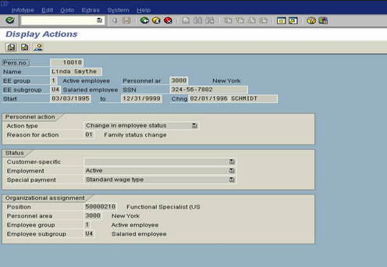
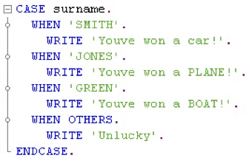

Changing Standards
What is Changing the Standard and What is Standard Here
A Program contains
Screen
Logic
Database Objects
So changing standard means
Changing
Standard Screen
Standard Program Logic
Standard Database Objects

Slide 3
Changing Standards
Personalization:
It is done by User for his GUI Screen
Configuration:
It is done by Function Counter Part/ System Analyst at the time of implementing the
SAP
Modification:
It is under Developer Scope. Adding additional logic in the Standard Program
Enhancement:
@ Screen level: Adding additional UI Elements in the Screen
@ Program Level: Adding additional logic
@DB Level: Additional fields in the Tables

Slide 4

Changing Standards
Standard Program
Modification – User Exit
User exits are Subroutines based. So we will write logic in side the FORM.. ENDFORM.
Need to add logic in side the Standard program so we need Access Key
User exits can access global data
Can only enhance logic
Global Declarations
Flow Logic
...
CALL FUNCTION <Function Module Name>
.
.
PERFORM <Form_Name>
.
.
PERFORMUser_exit_Form_Name.
…
PERFORM User_Exit_Form_Name
…
Form#1
Form#2
Form N
User Exit Form#1
User Exit Form#2

Slide 5
Changing Standards
Enhancement – Customer Exit
Standard Program
User exits are Function Group based.
We can enhance Logic as well as Screens
Within function Group, we can design Screens and write the Logic
Logic will be written in Function Modules
Custom Screens will be placed in sub screens
Custom logic will be called
Screen#1
Material
Plant
Screen#2
PBO
Call Sub Screen
PAI
PBO
Call Sub Screen
PAI
Sub screen Area
Sub screen Area
PBO Modules
PAI Modules
Subroutines
Declarations
Function Module
Function Module
Sub Screen
Sub Screen
Customer exit Function Group

Slide 6
Changing Standards
Enhancement – Customer Exit - Duplicate
Standard Program
Customer exits are Function Group based.
We can enhance Logic as well as Screens
Within function Group, we can design Screens and write the Logic
Logic will be written in Function Modules
Custom Screens will be placed in sub screens
Custom logic will be called
Screen#1
Material
Plant
Screen#2
PBO
Call Sub Screen
PAI
PBO
Call Sub Screen
PAI
Sub screen Area
Sub screen Area
PBO Modules
PAI Modules
Subroutines
Declarations
Function Module
Function Module
Sub Screen
Sub Screen
Customer exit Function Group

Slide 7
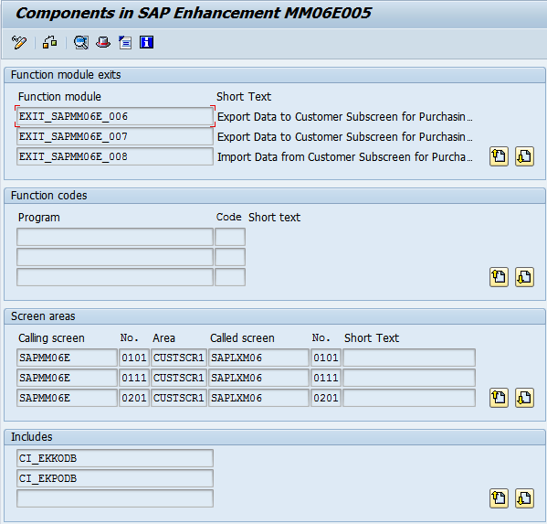
Changing Standards
Enhancement – Customer Exit
How to find the Customer Exits
SPRO
SE84
SE38
Check components of Customer Exit in SMOD
Implement Customer Exits using CMOD
Example:
Purchase Order Transaction Enhancement – MM06E005

Slide 8
Changing Standards
Enhancement – Customer Exit
Understand the Example
Customer Function Group: SAPLXM06. It contains
Screen Exits
Through which we can call our custom screen. So first need to design Custom Screen
Customer Function Modules
These help us to transfer data to and from Custom Screens
And we have Custom Includes to add Fields to the database tables
We can add custom fields to the table

Slide 9
Changing Standards
Enhancement – Business Addins
Standard Program
Badis are Interface/Class Based
We can enhance Logic as well as Screens
Within function Group, we can design Screens and write the Logic
Logic will be written in Function Modules
Custom Screens will be placed in sub screens
Custom logic will be called
Screen#1
Material
Plant
Screen#2
PBO
Call Sub Screen
PAI
PBO
Call Sub Screen
PAI
Sub screen Area
Sub screen Area
PBO Modules
PAI Modules
Subroutines
Declarations
Method
Method
Sub Screen
Sub Screen
Business Addin Interface
Business Addin Implementation
Business Addin Implementation
Business Addin Implementation

Slide 10
Changing Standards
Enhancement Framework
Enhancement Spot – Collection of all enhancements in a package/Program/Process
Implicit Enhancements – Predefined locations by SAP. Generally Start and end of Processing Block. Example: Start for Subroutine and End of Subroutine etc
Explicit Enhancement
Enhancement Option
Enhancement locations with in the Processing Block
Enhancement Point – Similar to BAdi
Enhancement Section – Collection of statements
Badis have been added in Enhancement Spots
Transaction Codes:
SE18 – Enhancement Spots
SE19 – Enhancement Implementation
SE20 – All the Implicit and explicit enhancement Operations

